Slide 1
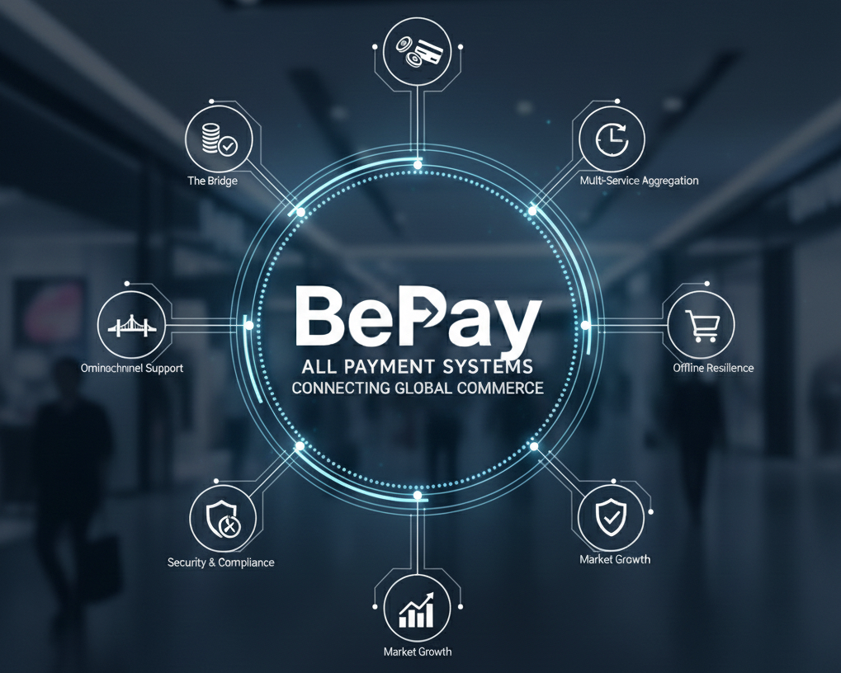

Slide 2
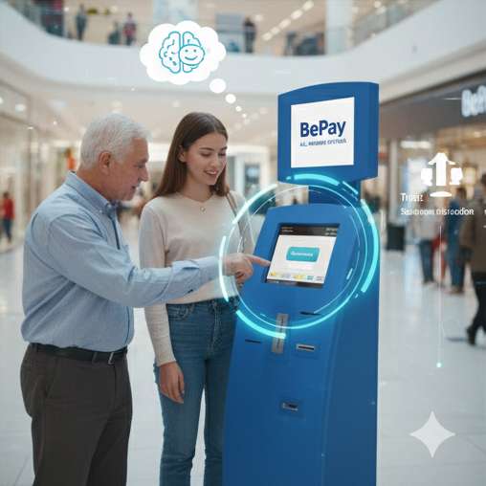
Our Mission
Payments Should Be Effortless
We believe that paying for anything - whether it’s a phone bill​, a coffee, or a crypto transaction – should be as easy and natural s sending a message. No friction, no confusion, no barriers.
Access for Everyone
Our mission is to empower people of all backgrounds. And technical levels. Whether you’re using cash, card, or crypto – whether you’re online or offline – our infrastructure makes payments accessible, intuitive, and instant.
Bridging the Old and the New
We connect traditional finance with the digital future. By merging cash-based habits with modern technologies like mobile wallets and blockchain, we create a seamless experience for users and merchants alike.

Slide 3
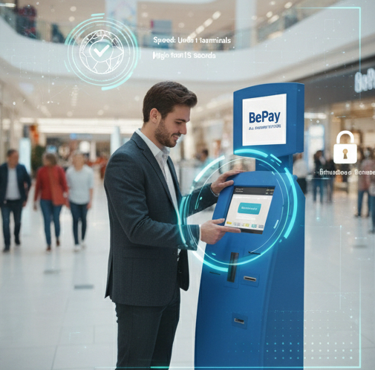
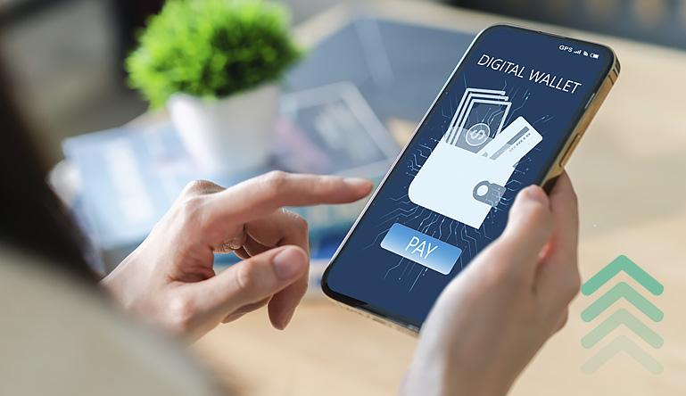
What We Offer
Smart Terminals
Accept cash, cards, QR codes and crypto – all in one place.
Digital Wallets
Seamless integration with Apple Pay, Google Pay and biometric payments.
Tap, scan, done.
Bill Aggregation
Pay for mobile, utilities, taxes and more – from a single interface.
Fast, intuitive, multilingual.
Instant Settlement
Merchants receive funds in real time. No delays, no batching – just instant confirmation

Slide 4

Crypto-Ready Infrastructure
Accept Crypto. Stay Fiat-Ready
Supported Assets
Bitcoin, Etherium, USDT - and more

Slide 5
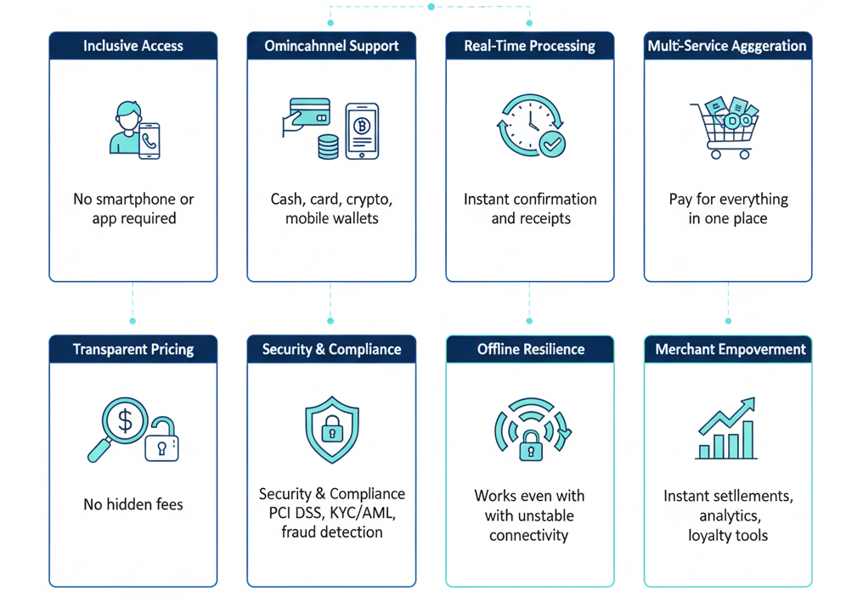
Epanded Benefits of Our Payment Experience

Slide 6
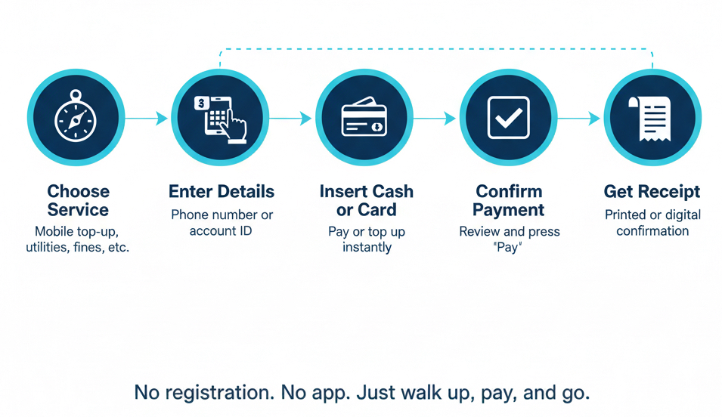
Terminal Flow

Slide 7
One Terminal. Endless Services
🧾 Merchant & Utility Payments
- Post-paid merchant payments
- Utility bill payments (electricity, water, gas)
- Recharge bill payments
💵 Cash Payments
- Cash deposits after non-functional hours
- Cash top-ups for wallets and accounts
💳 Card Payments
- Credit and debit card instalments
- One-time card payments
- Prepaid card top-ups
🎰 Gaming & Betting Services
- Online casino deposits
- Sports betting
- Lottery ticket payments
🛡️ Insurance Premiums
- Online health insurance premiums
- Vehicle insurance payments
- Life insurance premiums
- Travel insurance payments
🚗 Parking & Transport Services
- Parking fee payments
- Toll road payments
- Public transport top-ups
₿ Crypto Services
- Crypto wallet top-ups
- Fiat-to-crypto purchases
- Crypto-to-fiat conversion
- Stablecoin payments (USDT, USDC)
📮 Postal & Delivery Services
- Parcel tracking and payments
- Postal service fees
- Express delivery payments
🏦 Loan Repayments
- Interest due payments
- Loan clearance payments
- Microloan repayments

Slide 8
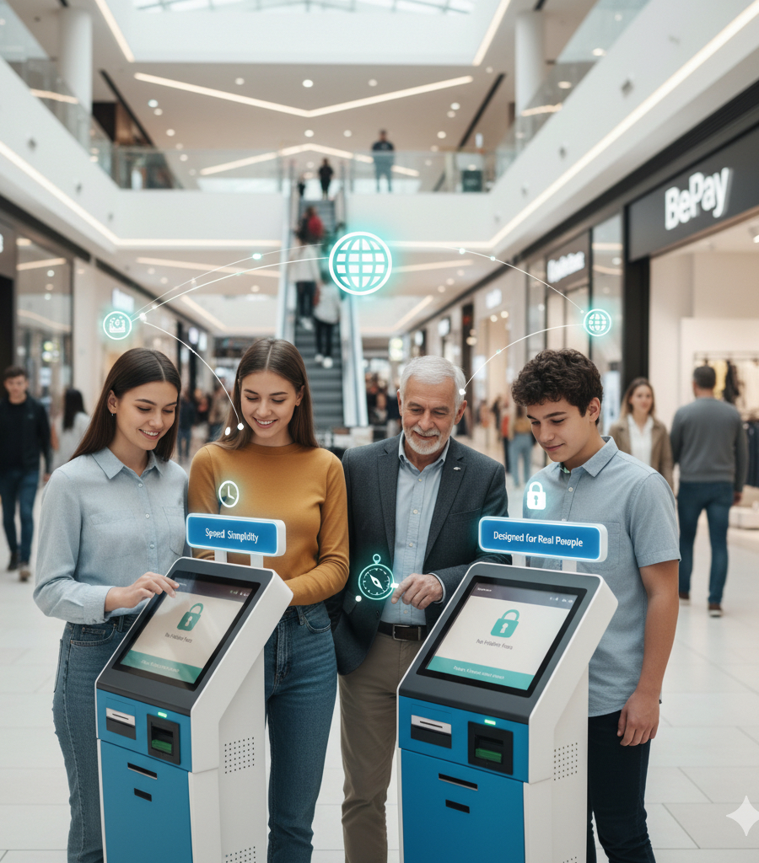
Why Customers Love Us
Speed
Payments completed in under 15 seconds
Simplicity
No learning curve – intuitive interface
Bridging the Old and the New
We connect traditional finance with the digital future. By merging cash-based habits with modern technologies like mobile wallets and blockchain, we create a seamless experience for users and merchants alike.

Slide 9
ADVANTAGES
High performance - up to 100,000 transactions per day
Flexible localization capabilities - support of full online portal switching to the available languages, including Arabic script and Chinese characters
High speed integration with cellular, ISP, MLM providers and banks
Detailed accounting - all terminals actions are logged and. available to the tech team in a monitoring subsystem, all cash
collections are automatically reconciled with payment data to detect
software errors and fraud
Simple and user-friendly interface

Slide 10
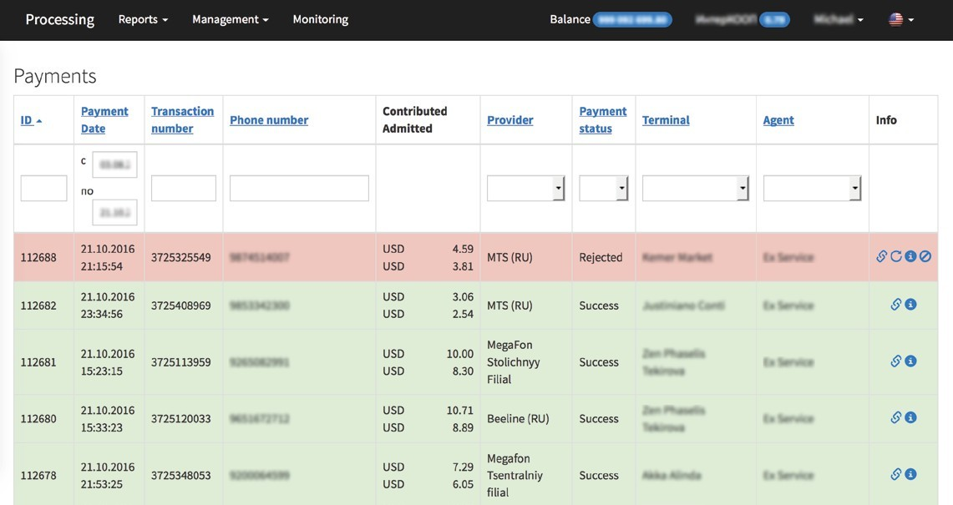

PAYMENTS
Convenient display and filtering payments for technical support
Payment cancellation process
(if it’s available in provider API)
Single and multi-payment reprocess in case of provider technical error or payer mistake
Extended information about the payment for technical support

Slide 11
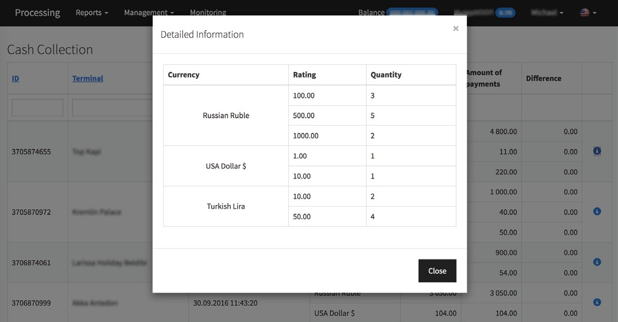
CASH COLLECTIONS
Summary and detailed cash collection information Multi-currency accounting
Automatic reconciliation of cash collection with payment data

Slide 12
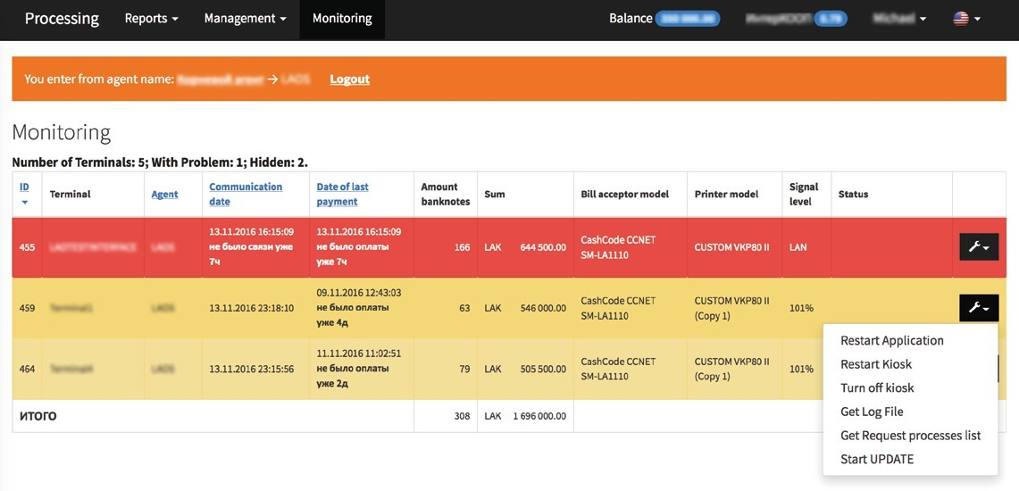
MONITORING
Detailed terminal state & payment information
Information about the printer, bill/coin acceptor models and state, connection quality
Visual and text kiosk status representation
Ability to perform service commands and query logs

Slide 13
KIOSK ADVANTAGES
Popular hardware equipment support: CashCode, NRI, Custom, etc.
Easy and rapid addition of new equipment
Fully customizable printable receipt
High performance and responsiveness of the interface through the use of modern technologies

Slide 14
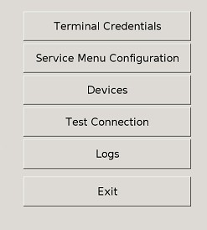
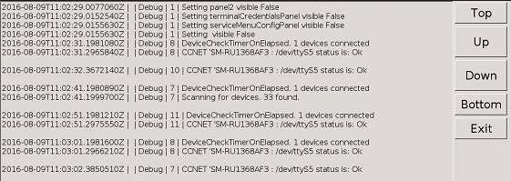
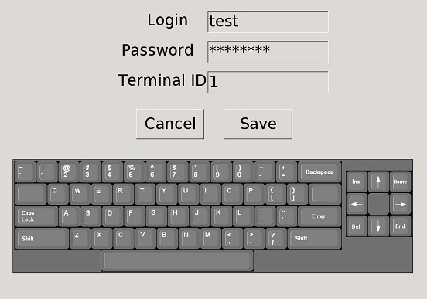
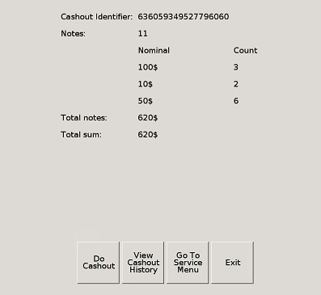
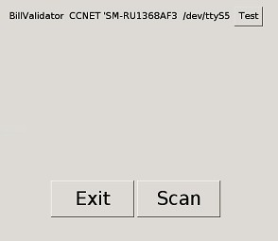
KIOSK FEATURES
Continuous equipment scan allows software to connect hardware without restart
Offline & online payment process
Targeted automatic reception updates from the FTP
Flexible fees including fixed amounts, percentage and customizable commissions profiles
Kiosk remote control including restart, reboot and shutdown

Slide 15
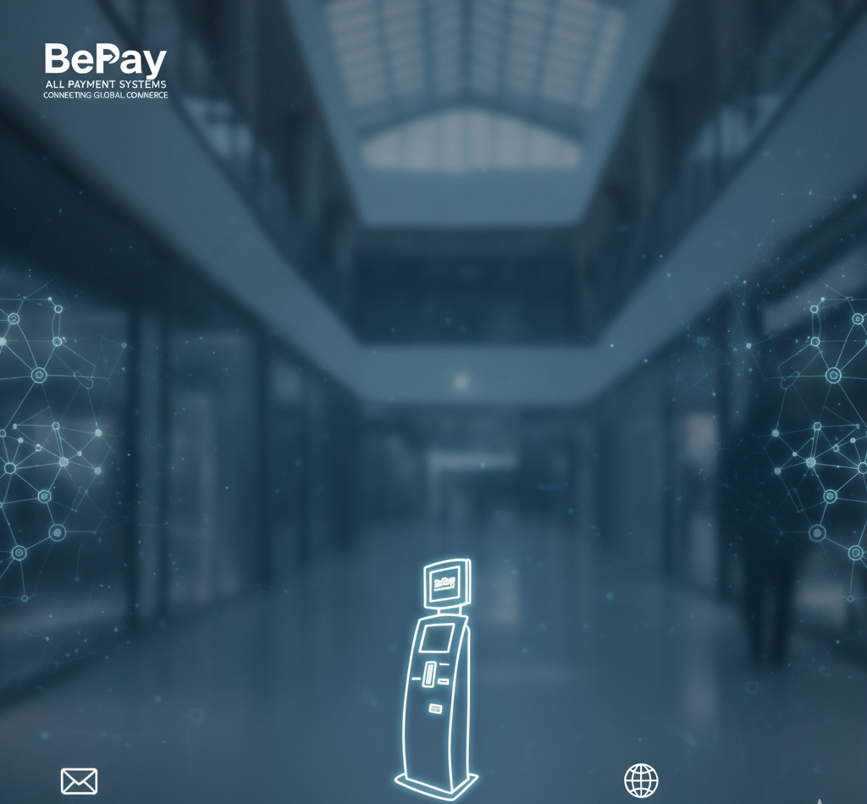
Let’s Build the Future
of Payments Together
We’re raising capital to expand our terminal network, enhance crypto infrastructure and onboard new service providers.
info@bepay.ge
www.bepay.ge

